Slide 1
Servlet-Request and Response

Slide 2

Objectives
At the end of this module you would be able to understand,
What is Request Object?
Process GET and POST Requests from Web Clients
Retrieve Parameters from HTML Client Forms
Retrieve path information
Determine what was requested and how
Retrieve request headers
Retrieve information uploaded as files
What is Response Object?
Structure of Response Object

Slide 3
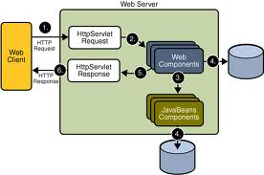
Servlet Request and Response Objects
Servlet Request and Response Objects?
HttpServlet gets request from a client (browser) on the HttpServletRequest interface and can return response to the client through the HttpServletResponse interface .
Notes:
ServletRequest and ServletResponse
Ther are two interfaces that serve as the backbone of servlet technology implementation. They belong to the javax.servlet package.
Signature: public interface ServletRequest Blueprint of an object to provide client request information to a servlet.
The servlet container creates a ServletRequest object and sends it as an argument to the servlet’s service method.
Signature: public interface ServletResponse Blueprint of an object to assist a servlet in sending a response to the client.
The servlet container creates a ServletResponse object and passes it as an argument to the servlet’s service method.
Data that needs to be sent to the client will be put inside the ServletResponse object. To send binary data back to the client in a MIME body response, use the ServletOutputStream from the ServletResponse object by calling the getOutputStream() method. To send character data to the client, the PrintWriter object returned by getWriter() should be used.

Slide 4
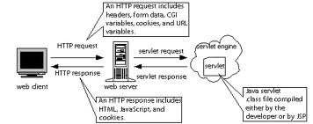
Servlet Request and Response Objects
What is a Request Object?
The HttpServletRequest object provides access to the request data, such as request headers, path info, and query string, as well as to some higher-level information such as cookies.
Notes:
The servlet container creates a ServletRequest object and passes it as an argument to the servlet's service method.
Request Headers:
When an HTTP client (e.g. a browser) sends a request, it is required to supply a request line (usually GET or POST). If it wants to, it can also send a number of headers, all of which are optional except for Content-Length, which is required only for POST requests. Here are the most common headers: Accept The MIME types the browser prefers.
Accept-Charset :The character set the browser expects.
Accept-Encoding :The types of data encodings (such as gzip) the browser knows how to decode. Servlets can explicitly check for gzip support and return gzipped HTML pages to browsers that support them, setting the Content-Encoding response header to indicate that they are gzipped. In many cases, this can reduce page download times by a factor of five or ten.
Accept-Language :The language the browser is expecting, in case the server has versions in more than one language.
Authorization :Authorization info, usually in response to a WWW-Authenticate header from the server.
Connection :Use persistent connection? If a servlet gets a Keep-Alive value here, or gets a request line indicating HTTP 1.1 (where persistent connections are the default), it may be able to take advantage of persistent connections, saving significant time for Web pages that include several small pieces (images or applet classes). To do this, it needs to send a Content-Length header in the response, which is most easily accomplished by writing into a ByteArrayOutputStream, then looking up the size just before writing it out.
Content-Length (for POST messages, how much data is attached)
Cookie :(one of the most important headers; see separate section in this tutorial on handling cookies)
From :(email address of requester; only used by Web spiders and other custom clients, not by browsers)
Host :(host and port as listed in the original URL)

Slide 5
Notes:
If-Modified-Since :(only return documents newer than this, otherwise send a 304 "Not Modified" response)
Pragma :(the no-cache value indicates that the server should return a fresh document, even if it is a proxy with a local copy)
Referer :(the URL of the page containing the link the user followed to get to current page)
User-Agent: (type of browser, useful if servlet is returning browser-specific content)
Example : To display the request Headers
import java.io.*;
import javax.servlet.*;
import javax.servlet.http.*;
import java.util.*;
public class ShowRequestHeaders extends HttpServlet {
public void doGet(HttpServletRequest request, HttpServletResponse response) throws ServletException, IOException {
response.setContentType("text/html");
PrintWriter out = response.getWriter();
String title = "Servlet Example: Showing Request Headers";
out.println(ServletUtilities.headWithTitle(title) + "<BODY BGCOLOR=\"#FDF5E6\">\n" + "<H1 ALIGN=CENTER>" + title + "</H1>\n" + "<B>Request Method: </B>" + request.getMethod() + "<BR>\n" + "<B>Request URI: </B>" + request.getRequestURI() + "<BR>\n" + "<B>Request Protocol: </B>" + request.getProtocol() + "<BR><BR>\n" + "<TABLE BORDER=1 ALIGN=CENTER>\n" + "<TR BGCOLOR=\"#FFAD00\">\n" + "<TH>Header Name<TH>Header Value");
Enumeration headerNames = request.getHeaderNames();
while(headerNames.hasMoreElements()) {
String headerName = (String)headerNames.nextElement();
out.println("<TR><TD>" + headerName); out.println(" <TD>" + request.getHeader(headerName));
}
out.println("</TABLE>\n</BODY></HTML>");
}
public void doPost(HttpServletRequest request, HttpServletResponse response) throws ServletException, IOException { doGet(request, response);
}
}

Slide 6
Servlet Request and Response Object
Servlet Request Object:
Processing Form Data:
The servlet receives parameters using these methods:
public String ServletRequest.getParameter (String name)
public String[] ServletRequest.getParameterValues (String name)
public Enumeration ServletRequest.getParameterNames()
public String ServletRequest.getQueryString()
Notes:
Processing Get and Post Requests from Web Clients:
When a servlet accepts a service call from a client, it receives two objects, ServletRequest and ServletResponse. The ServletRequest class encapsulates the communication from the client to the server, while the ServletResponse class encapsulates the communication from the servlet back to the client.
Request parameters:
The ServletRequest (or HttpServletRequest object if you are using HttpServlet) contains a lot of information. We shall see how servlet processes form parameters.
public String ServletRequest.getParameter (String name): This returns the value of the named parameter as a String or null if parameter wasn’t specified.
public String[] ServletRequest.getParameterValues (String name): It returns values of named parameter as a String array if parameter could have multiple values, as in the case of list element with multiple select.
public Enumeration ServletRequest.getParameterNames(): It returns a list of parameter names.
public String ServletRequest.getQueryString(): It returns the raw query string of the request.

Slide 7
Servlet Request and Response Object
Servlet Request Object:
Path Elements:
Context path: The prefix for the deployed application.
Servlet path : The prefix that mapped to servlet handling the request.
Path info :The remaining segment of the request path after the context path or the servlet path.
The servlet can use the getPathInfo( ) method to get extra path information:
public String HttpServletRequest.getPathInfo( )
Example: http://server:port/servlet/ViewFile/index.html
The getPathTranslated( ) method returns the extra path information translated to a real file system path or null if there is no extra path information.
public String HttpServletRequest.getPathTranslated( )
Notes:
URL Path Elements
An HTTP request always contains a URL to uniquely identify the resource that client wants to access. The URL contains several pieces of information put together in a string, including: the protocol and endpoint information that allowed the networking infrastructure to send the request to servlet container; the request path made of the prefix that is mapped to a specific servlet and the remaining resource identifier handled by the servlet; and a query string.
Below, the general structure of an URL: http://<host>:<port><request path>?<query string> The Servlet API distinguishes and provided accesses to several sub-segments of the request path:
Context path: The prefix for the deployed application. Servlet path The prefix that mapped to servlet handling the request.
Path info : The remaining segment of the request path adter the context path or the servlet path. Table below shown some examples of parsing URLs into sub-segments.
Retrieving Path Information:
In addition to parameters, an HTTP request can include something called “extra path information”. This extra path information can be used to indicate a file on the server or some piece of information that the servlet can use for something. This path information is encoded in the URL of an HTTP request. An example URL looks as follows:
http://server:port/servlet/ViewFile/index.html
This invokes the ViewFile servlet, passing “/index.html” as extra path information. A servlet can access this path information using the getPathInfo( ) method. String pathname = request.getPathInfo();
If the extra path information is the name of a file, then a servlet can get the actual file system location of the file using getPathTranslated( ) method:
String filename = request.getPathTranslated( )
This method returns the extra path information translated to a real file system path or null if there is no extra path information. The returned path does not necessarily point to an existing file or directory. An example, translated path is “D:\tomcat\jakarta-tomcat-4.0.1\webapps\ServletDemo/html/index.html”.

Slide 8
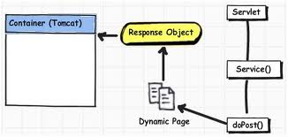
Servlet Objects and Methods
What is a Response Object?
It represents the HTTP response your web application sends back to the browser, in response to the HTTP request the browser send to your web application.

Slide 9
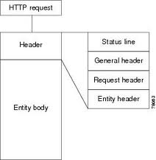
Servlet Objects and Methods
The Structure of a Response:
An HTTP servlet can return three kinds of things to the client: a single status code, any number of HTTP headers, and a response body.
status code : An integer value describing the status of the response.
The response body is the main content of the response.
Notes:
Structure of a Response:
As part of Servlet lifecycle, we saw how response object is obtained. We saw examples of servlets where we used response object to set response type (response.setContentType()) and obtain the PrintWriter object to send response to browser (response.getWriter()).
We shall see the HttpServletResponse object in more detail.
When a web server responds to a request, the response typically consists of a status line, some response headers and the response body itself.
The status line consists of HTTP version, a status code, and a very short message corresponding to the status code.
The response headers are optional except for “content-type” which specifies the MIME type of the document being sent.
The response body contains the actual response that the browser lays out. A response body can be of any type and of any length. The client knows what to expect by reading and interpreting the HTTP headers in the response.
Servlets can perform a number of important tasks by manipulating the status line and the response headers. For example, they can redirect the user to other sites, indicate the document type (image, PDF, and so on) to browser, tell the user that s/he is required to authenticate herself/himself before s/he can access any pages, and so on.

Slide 10
Servlet Objects and Methods
Structure of Response:
Status Code:
The status line consists of HTTP version, a status code, and a short message corresponding to the status code
The HTTP version is set by server and message is directly associated with status code. Therefore a servlet needs to only set the status code.
public void HttpServletResponse.setStatus(int sc): It sets response status code.
If a servlet sets a status code that indicates an error during the handling of the request, then it can sendError() instead of setStatus():
public void HttpServletResponse.sendError(int sc)
public void HttpServletResponse.sendError(int sc,String sm)
Notes:
Concept of Status Codes:
As mentioned on the previous page, the status line consists of HTTP version, a status code, and a short message corresponding to the status code. The HTTP version is set by server and message is directly associated with status code. Therefore a servlet needs to only set the status code.
HTTP status codes are returned by the server to the client to determine the outcome of a request. The status code can indicate success or failure, or it can tell the client software to take further action to finish the request. A status code works behind the scenes and is interpreted by the browser software. If a servlet does not specifically set the status code, the server steps in and sets its value to the default 200 “OK” status.
Status codes are three-digit integer values, the first digit of the code indicates the class of the status. To quote from the spec:
1xx: Informational - Request received, continuing process
2xx: Success - The action was successfully received, understood, and accepted
3xx: Redirection - Further action must be taken in order to complete the request
4xx: Client Error - The request contains bad syntax or cannot be fulfilled
5xx: Server Error - The server failed to fulfill an apparently valid request

Slide 11
Servlet Objects and Methods
Notes:
Knowledge of these response codes will assist you in debugging any problems with your Web applications. Note that a 500 series response often occurs if you have a problem with the configuration for your servlets, or if the servlet fails to run correctly (such as might occur when an uncaught exception is thrown).
Example: Common HTTP Response Codes
200 OK :Standard response for the successful request of a page.
301 Moved Permanently :The requested resource has been moved to a new location. The Location header indicates the URI of the new location. The client should request the page from this new URI.
304 Not Modified :This is returned when a client requests a page and specifies the If-modified-since header in the request. The server will return code 304 rather than 200 if the page has not changed since the indicated modification date. This protocol is used to improve efficiency when a browser is caching local copies of Web pages.
307 Temporary Redirect:The requested resource has been temporarily moved to a new location. The Location header indicates the URI of the new location. The client should request the page from this new URI. If you request the URI http://localhost:8080/ from Tomcat, you will get this response code, together with the header Location=http:// localhost:8080/index.html.
401 Unauthorized :Used when a client is not authorized to access a resource. This response is covered in more detail in Chapter 14, "Access Control."
403 Forbidden:Access to the resource is denied, and the server might supply further information in the response body.
404 Not Found:The requested URI was not found on the server. This response might also be used to deny access without giving further information.
414 Request-URI Too Long:This is returned when a GET URI is too long for the server to process.
500 Internal Server Error:Unknown internal error. In Tomcat, this is often a result of errors in the XML configuration files for a Web application (see Chapter 4, "Basic Principles of Servlets" and Appendix B, "Template web.xml File").
503 Service Unavailable:This can be used by a servlet to show that an external resource (perhaps a database) is not available. The client can retry the request at a later time.
Status codes are defined as mnemonic constants in the HttpServletResponse class. For example: SC_OK for status code 200 and SC_NOT_FOUND for status code 404! For a full list, refer the HttpServletResponse class in the Servlet 2.5 documentation.
A Servlet can use the setStatus() method to set response status code. Remember, the setStatus( ) method should be called before your servlet returns any of its response body. A servlet can use sendError(int sc) (sc indicates the status code to indicate error during handling of request. In this case, the server generates and sends a server-specific page describing the error.)

Slide 12
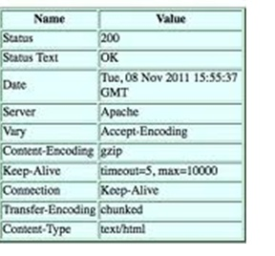
Servlet Objects and Methods
Structure of Response:
The HTTP response headers are as follows:
Cache-Control
Pragma
Refresh
Connection
Retry-After
Expires
Location
WWW-Authenticate
Content-Encoding
Notes:
Setting Response Headers:
After the status line are the general headers, the response header, and the entity headers, followed by the message body.
A servlet can set response headers to provide more information about its response. HTTP version 1.0 and 1.1 define a large number of request and response headers, description of which is beyond the scope of this course. Some of the most commonly used HTTP headers are listed below:
Cache-Control: It tells all caching mechanisms from server to client whether they may cache this object. For example: Cache-Control: no-cache
Pragma: The HTTP 1.0 equivalent of Cache-Control, with no-cache as its only possible value.
Connection: It is used to indicate whether the server is willing to maintain an open connection to the client. If so, its value is set to keep-alive.
Retry-After: If an entity is temporarily unavailable, this instructs the client to try again after a specified period of time (in seconds). For example: Retry-After: 120
Expires: It gives the date/time after which the response is considered stale. For example: Expires: Thu, 01 Dec 2009 16:00:00 GMT
Location: It is used in redirection, or when a new resource has been created. Its value must be a fully qualified URL.
WWW-Authenticate: It indicates the authentication scheme that should be used to access the requested entity. WWW-Authenticate: Basic
Content-Encoding: The type of encoding used on the data. For example: Content-Encoding: gzip
Refresh: It is used in redirection, or when a new resource has been created.

Slide 13
Servlet Objects and Methods
Structure of Response:
HttpResponse Header: Redirecting a Request
Request can be redirected by either:
response.setStatus(res.SC_MOVED_TEMPORARILY); response.setHeader("Location", site);
response.sendRedirect(site);
sendRedirect() syntax:
public void HttpServletResponse.sendRedirect(String location) : This method creates a roundtrip to the client and hence a new request for server.
Notes:
Setting Response Headers:
HTTP response headers can be used to give forwarding location, specify cookies, supply the page modification date, instruct the browser to reload the page after a designated interval, designate the type of document being generated, and so on.
Methods for setting arbitrary response headers are as follows:
The setHeader( String name, String value ) method sets the value of the named header as a string. For example: res.setHeader(“Location”, new_location);
Use the setDateHeader( String name, long date ) method, if you need to specify a timestamp for a header. It sets the value of the named header with the given name and date-value.
Use the setIntHeader( String name, int value) method to specify an integer value for a header.
The containsHeader() method returns a boolean indicating whether the named response header has already been set.
Other than these methods, there are some additional methods to set response headers:
setContentType: Sets the Content- Type header
setContentLength: Sets the Content- Length header
addCookie: Adds a value to the Set- Cookie header
sendRedirect: Sets the Location header and changes status code
Redirecting a Request:
One of the useful things a servlet can do using status codes and a header is redirecting a request. This is done by sending instructions to the client, to use another URL in the response. Redirection is generally used when a document moves (to send the client to the new location), for load balancing (so one URL can distribute the load to several different machine), or for simple randomization (choosing a destination at random).
The actual redirection happens in two lines:
res.setStatus(res.SC_MOVED_TEMPORARILY);
res.setHeader("Location", site);
The first line sets the status code to indicate a redirection is to take place, while the second line gives the new location.
These two lines can be simplified to one using the sendRedirect( ) convenience method:
public void HttpServletResponse.sendRedirect(String location) throws IOException.
This method redirects the response to the specified location, automatically setting the status code and location headers. For our example, the two lines simply become:
res.sendRedirect(site);
Example:
import java.io.*;
import java.util.*;
import javax.servlet.*;
import javax.servlet.http.*;
public class SiteSelector extends HttpServlet {
Vector sites = new Vector();
Random random = new Random();
public void init(ServletConfig config) throws ServletException { super.init(config); sites.addElement("http://www.oreilly.com/catalog/jservlet"); sites.addElement("http://www.servlets.com"); sites.addElement("http://jserv.java.sun.com"); sites.addElement("http://www.servletcentral.com");
}
public void doGet(HttpServletRequest req, HttpServletResponse res) throws ServletException, IOException {
res.setContentType("text/html");
PrintWriter out = res.getWriter();
int siteIndex = Math.abs(random.nextInt()) % sites.size();
String site = (String)sites.elementAt(siteIndex);
res.setStatus(res.SC_MOVED_TEMPORARILY);
res.setHeader("Location", site);
}
}

Slide 14
Servlet Objects and Methods
Notes:
Redirecting a Request:
One of the useful things a servlet can do using status codes and a header is redirecting a request. This is done by sending instructions to the client, to use another URL in the response. Redirection is generally used when a document moves (to send the client to the new location), for load balancing (so one URL can distribute the load to several different machine), or for simple randomization (choosing a destination at random).
The actual redirection happens in two lines:
res.setStatus(res.SC_MOVED_TEMPORARILY);
res.setHeader("Location", site);
The first line sets the status code to indicate a redirection is to take place, while the second line gives the new location.
These two lines can be simplified to one using the sendRedirect( ) convenience method:
public void HttpServletResponse.sendRedirect(String location) throws IOException.
This method redirects the response to the specified location, automatically setting the status code and location headers. For our example, the two lines simply become:
res.sendRedirect(site);
Example:
import java.io.*;
import java.util.*;
import javax.servlet.*;
import javax.servlet.http.*;
public class SiteSelector extends HttpServlet {
Vector sites = new Vector();
Random random = new Random();
public void init(ServletConfig config) throws ServletException { super.init(config); sites.addElement("http://www.oreilly.com/catalog/jservlet"); sites.addElement("http://www.servlets.com"); sites.addElement("http://jserv.java.sun.com"); sites.addElement("http://www.servletcentral.com");
}
public void doGet(HttpServletRequest req, HttpServletResponse res) throws ServletException, IOException {
res.setContentType("text/html");
PrintWriter out = res.getWriter();
int siteIndex = Math.abs(random.nextInt()) % sites.size();
String site = (String)sites.elementAt(siteIndex);
res.setStatus(res.SC_MOVED_TEMPORARILY);
res.setHeader("Location", site);
}
}
}

Slide 15

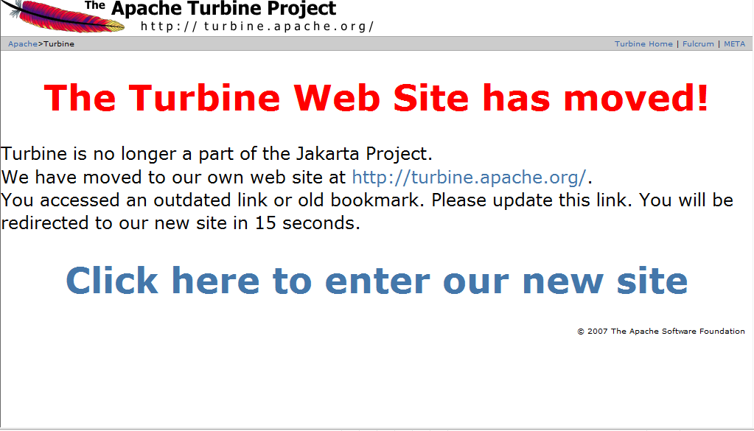
Test your Memory…
Have you come across similar sites ?
Notes:
At times you may want to
Update the document so that it acts like a ticker-tape .
you may want to load a different document dynamically after every 30 seconds.
Your URL has changed and you want users to be redirected to a new URL automatically

Slide 16

Queries
What happens after 15 seconds?
How is it done?
Client Pull
Notes:
"Client pull" refers to a technique that enables clients such as Web browsers to request pages(pull pages) from the server automatically without user intervention. This is usually done by the use of a refresh header.
Why is this useful?
For two reasons:
First, the content from the first page can explain to the client that the requested page has moved before the next page is automatically loaded.
Second, pages can be retrieved in sequence, making it possible to present a slow-motion page animation.
Client pull is similar to redirection, with one major difference – the browser actually displays the content from the first page and waits for some specified amount of time before retrieving and displaying the content from the next page. It is called client pull because the client is responsible for pulling the content from the next page.

Slide 17
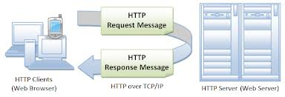
Servlet Objects and Methods
Structure of Response
HttpResponse Header: ClientPull
Almost similar to redirection, with the exception , the browser actually displays the content from the first before retrieving and displaying the content from the next page.
res.setHeader(“Refresh”, “3” ): This method tells the client to reload same servlet after showing its current content for three seconds.
res.setHeader(“Refresh”, “3;URL=url” ): This method tells client to load page at URL url after three seconds.
Notes:
ClientPull:
Client pull information is sent to the client using the Refresh HTTP header. This header’s value specifies the number of seconds to display the page before pulling the next one, and it optionally includes a URL string that specifies the URL from which to pull. If no URL is given the same URL is used. Some examples follow:
A call to setHeader( ) that tells the client to reload this same servlet after showing its current content for three seconds:
setHeader(“Refresh”, “3” );
setHeader(“Refresh”, “3;URL=https://syntelligence.syntelinc.com” ); :method call tells client to display Syntelligence page after three seconds.
Example:
import java.io.*; import java.sql.Date; import java.util.*; import javax.servlet.*; import javax.servlet.http.*; public class ClientPull extends HttpServlet{ public void doGet(HttpServletRequest req,HttpServletResponse res)throws ServletException,IOException{ res.setContentType("text/plain"); PrintWriter out= res.getWriter(); res.setHeader("Refresh","10"); out.println(new Date().toString()); } }

Slide 18

Brainstorm

Slide 19
Queries

Slide 20

Recap
In this lesson, you have learnt:
Structure of a Response
Setting response headers

Slide 21
Quiz…
1) Browsers that support content encoding feature, indicate that they do so by setting the ___ request header.
Option 1: Cache-Control
Option 2: Encoding-true
Option 3: Accept-Encoding
Option 4: Content-Encoding
Answer :Option 3: Accept-Encoding
2) What happens when the servlet is asked to return a file that does not exist
Answer : SC_NOT_FOUND is returned

